Slide 1
Wrangle Conference 2017
Alejandro Lopez
2017-06

Slide 2
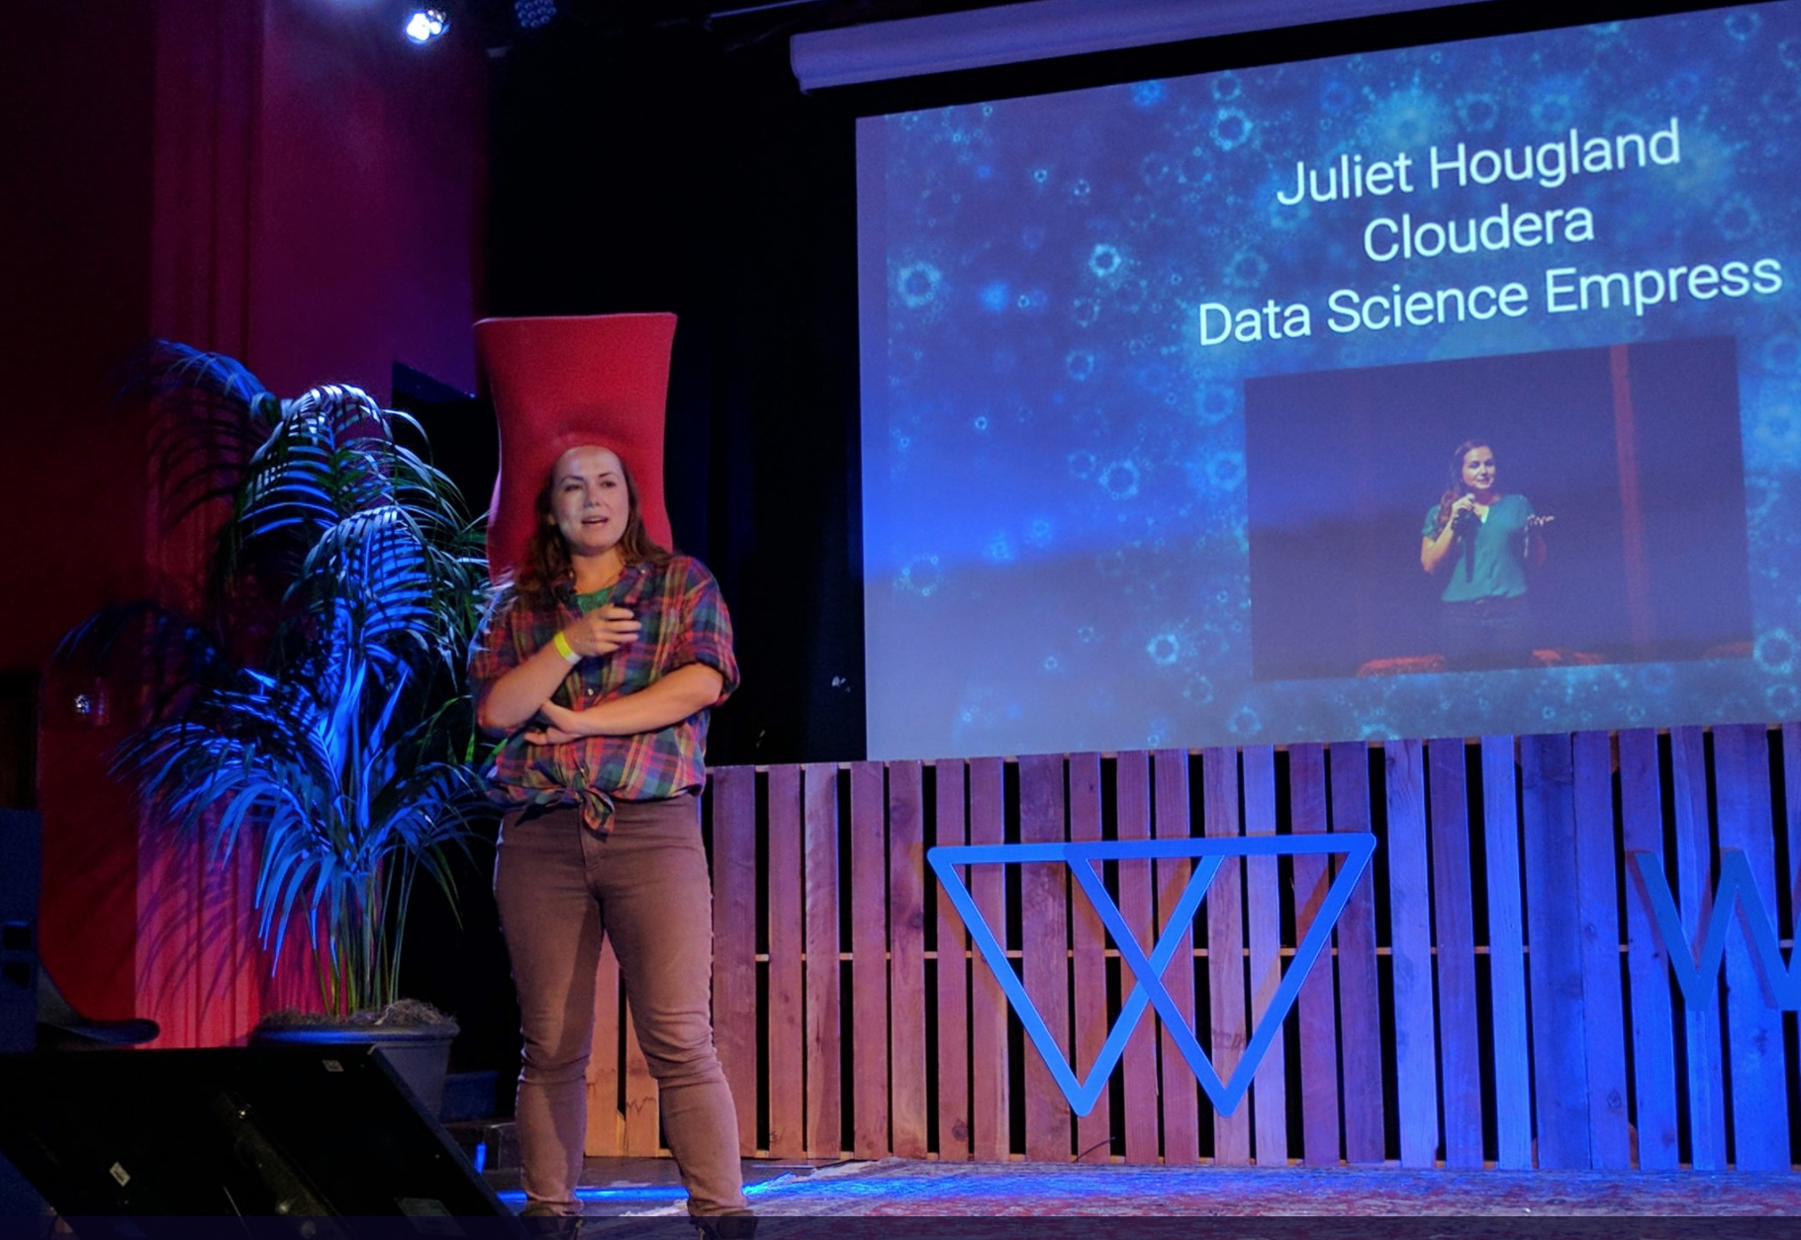
2017-06

Slide 3
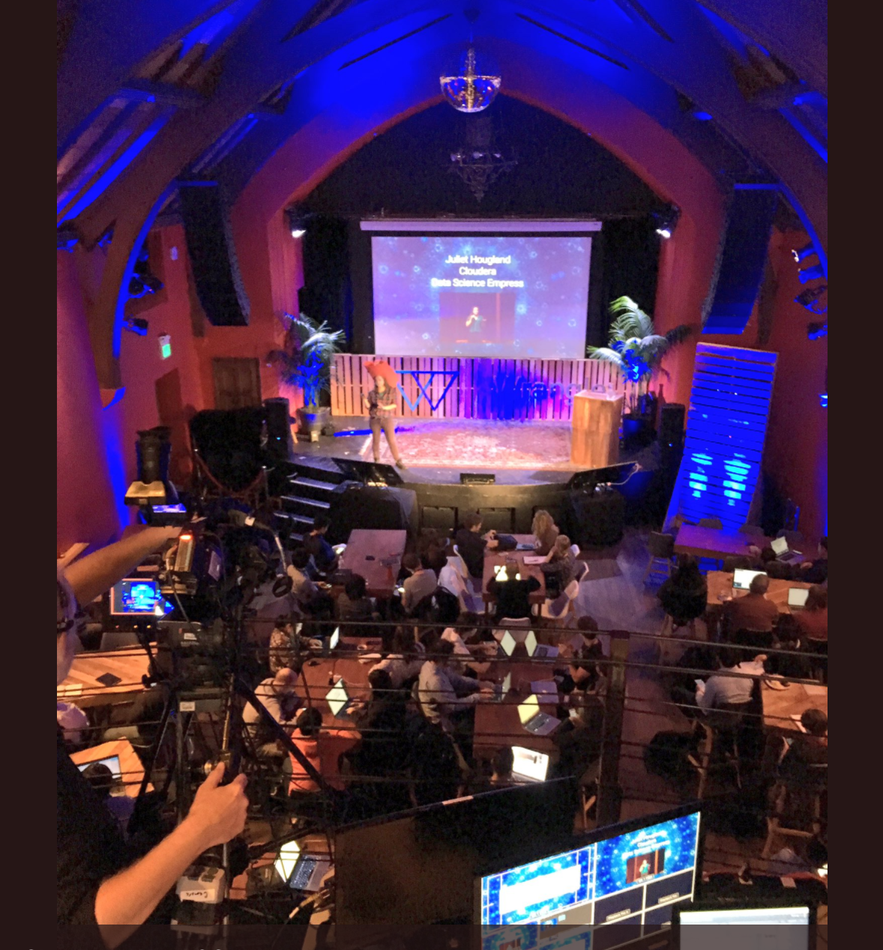
2017-06

Slide 4
In this talk
What makes a good Data Scientist?
Data Science in the Industry.
How to productionize data science models?
References:
https://www.slideshare.net/search/slideshow?searchfrom=header&q=wrangle+conference+2017&ud=any&ft=all&lang=**&sort=
http://wrangleconf.com/
https://twitter.com/hashtag/wrangleconf?f=tweets&vertical=default
http://martin.zinkevich.org/rules_of_ml/rules_of_ml.pdf

Slide 5
What makes a good DS
What would a CIA data scientist do?
– Drew Conway (Aluvium)
Cognizant of bias in our work:
Motivated Reasoning
Confirmation Bias
Denial
Communicating our results
2. The Ethics of Everybody Else
– Tyler Schnoebelen (Integrate.ai)
Consider the impact of your work on others
Technology doesn’t just happen

Slide 6
Bias
"Collect biased imperfect data & use
biased imperfect tools to make
inferences about opaque world"

Slide 7
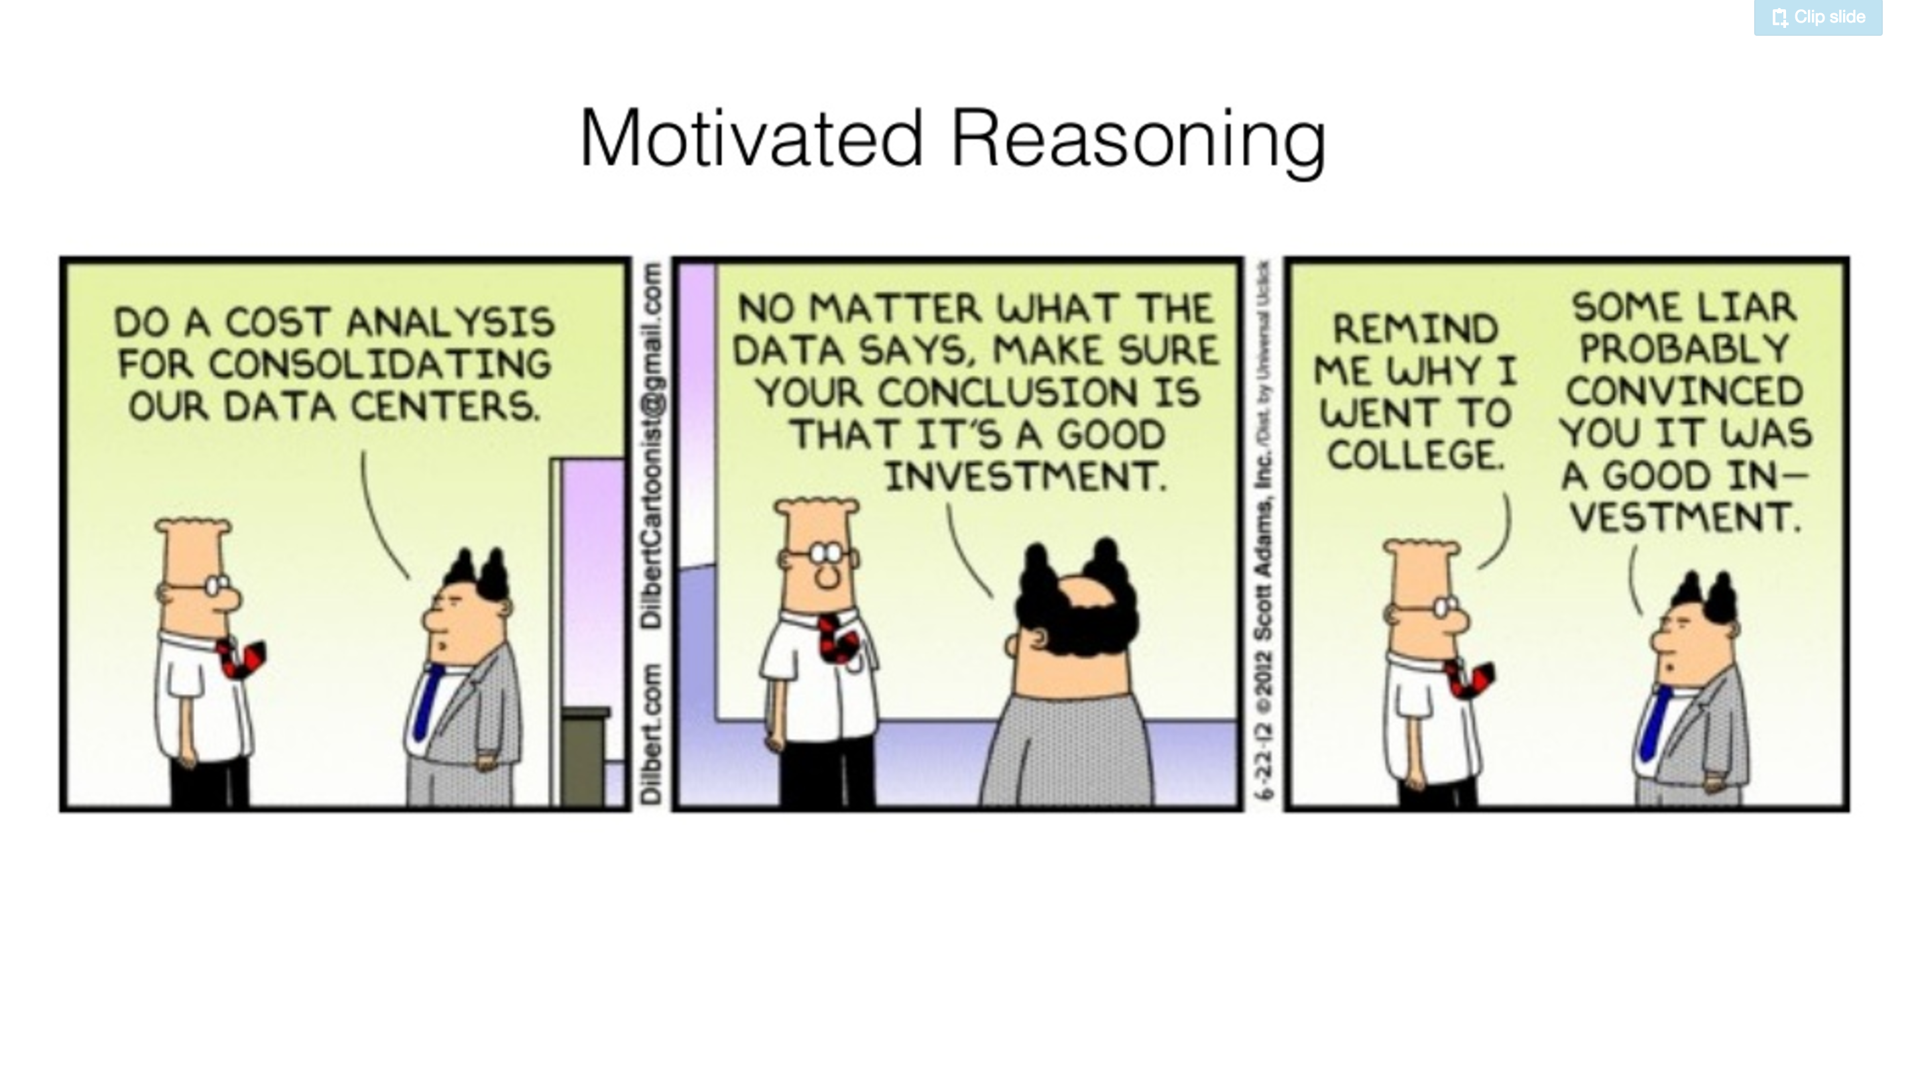
Bias: Motivated Reasoning

Slide 8
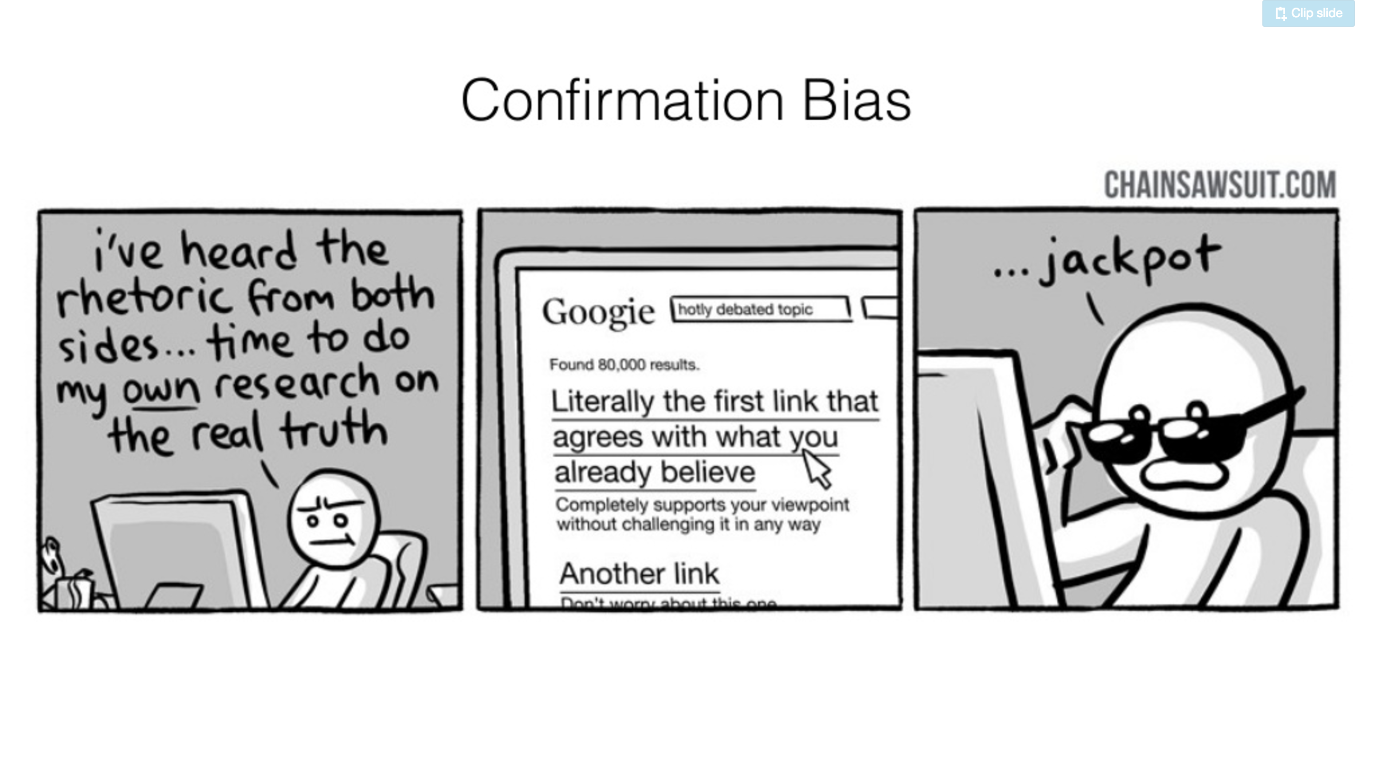
Bias: Confirmation Bias

Slide 9
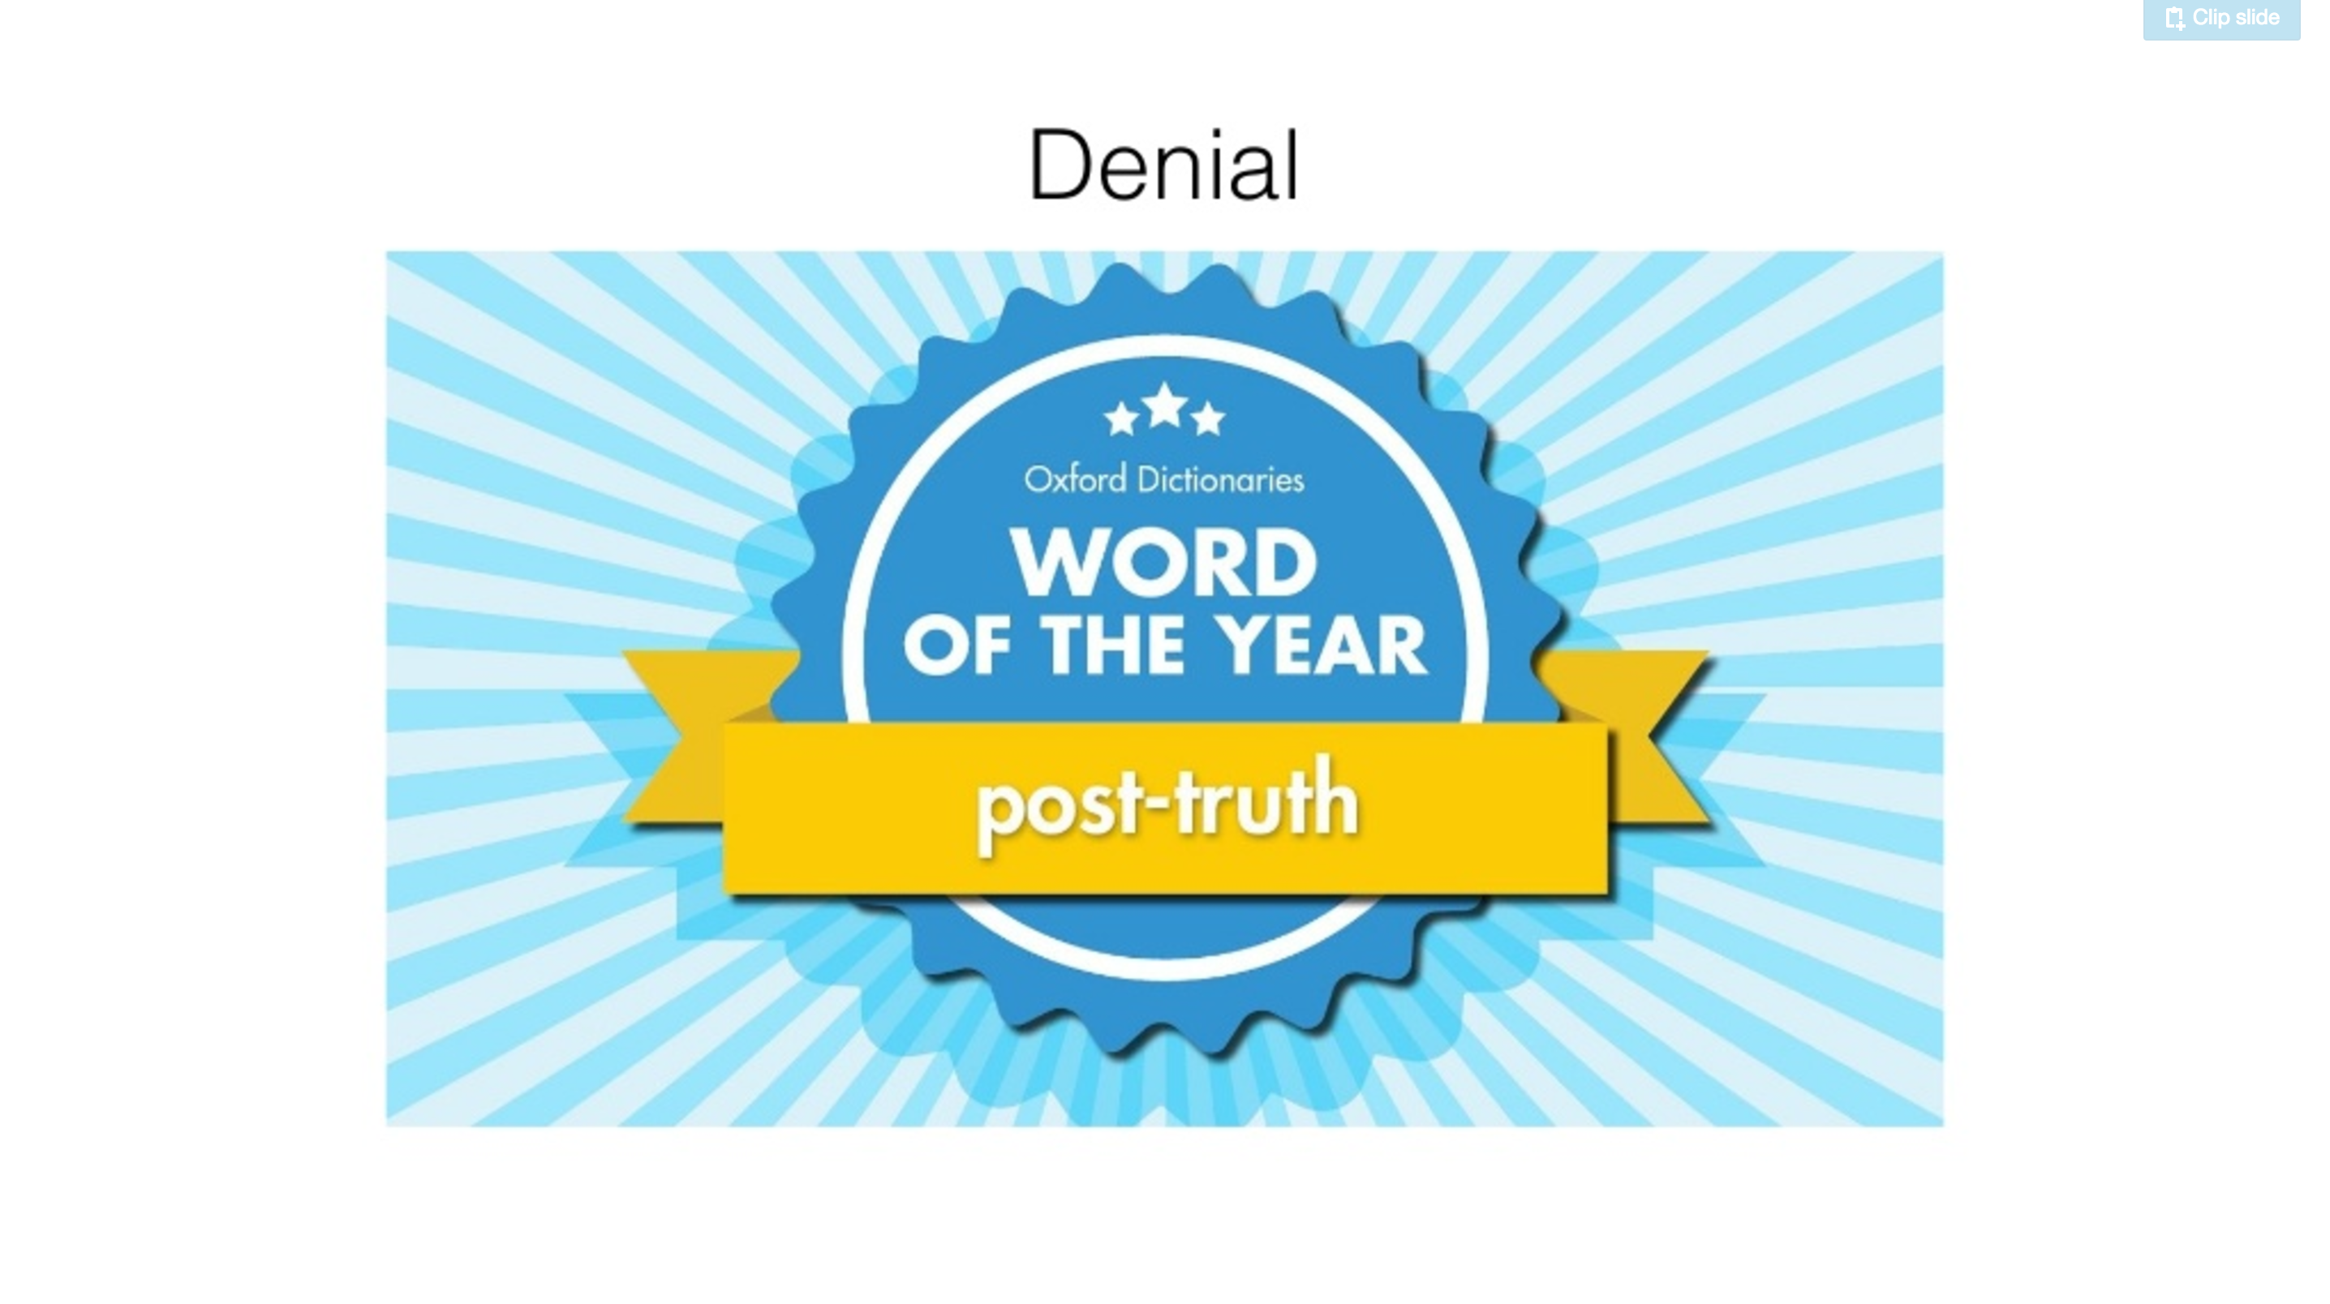
Bias: Denial

Slide 10
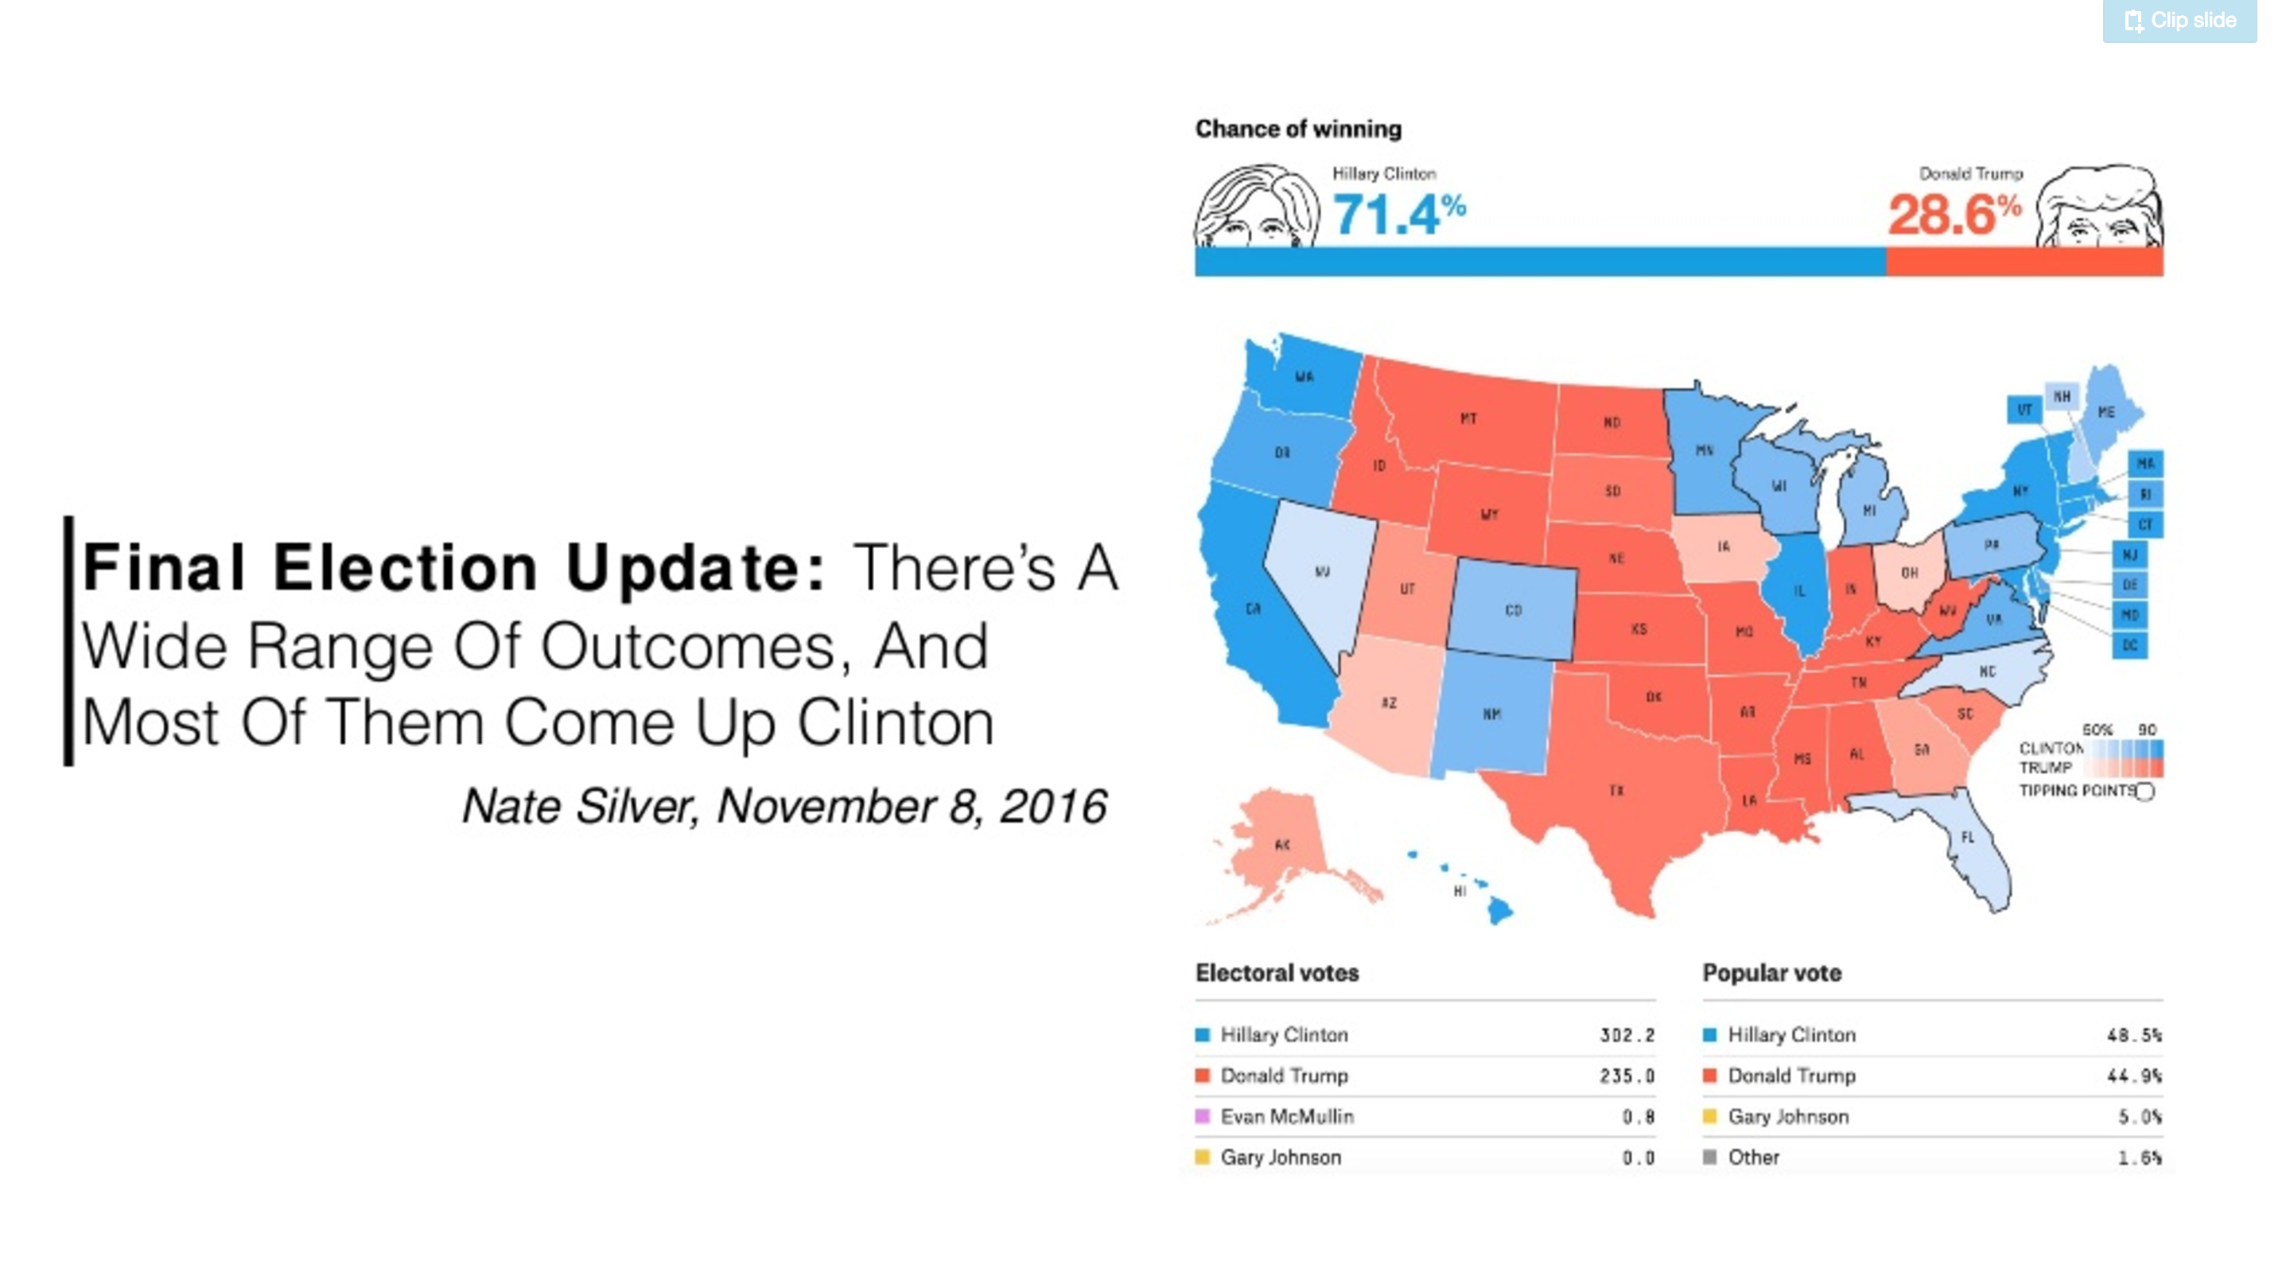
Communicating our Results
Drew Conway: ’What was once the realm of the "unicorns" and "rocks stars," is now a place of scorn and ridicule.’

Slide 11
What makes a good DS
What would a CIA data scientist do?
– Drew Conway (Aluvium)
Cognizant of bias in our work:
Motivated Reasoning
Confirmation Bias
Denial
Communicating our results
2. The Ethics of Everybody Else
– Tyler Schnoebelen (Integrate.ai)
Consider the impact of your work on others
Technology doesn’t just happen

Slide 12
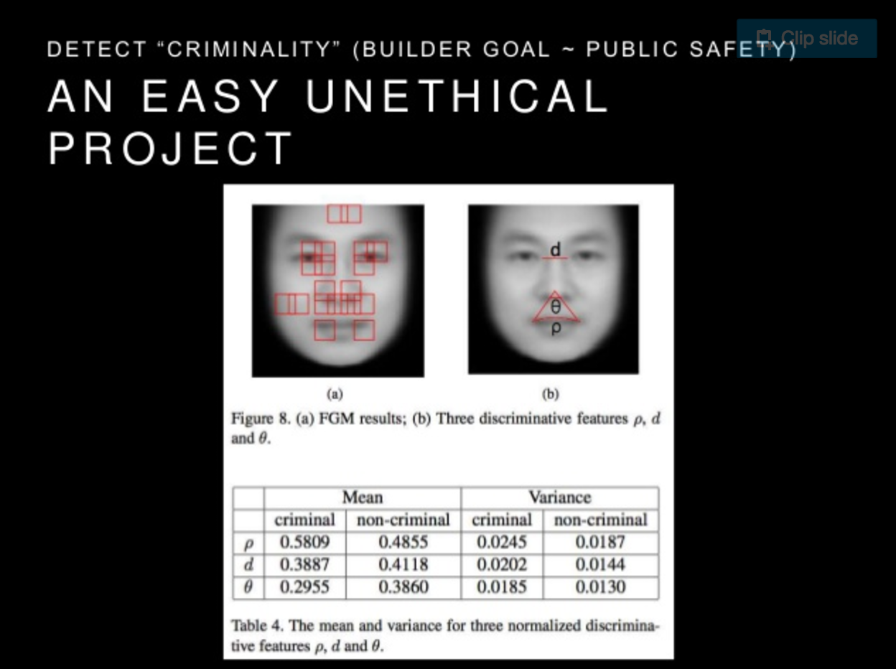

Slide 13
Data Science in Industry
Measurement with Intention – Sean Taylor (Facebook)
“We never directly observe the processes we are trying to monitor”
What defines a good metric: Cost, Simplicity, Faithfulness, Precise and Casual Proximity
Unlocking the Power of Social Chatter;
Recent Endeavors @ Netflix - Sui Huang (Netflix)
Capitalizing and utilizing external data sources for model building.

Slide 14
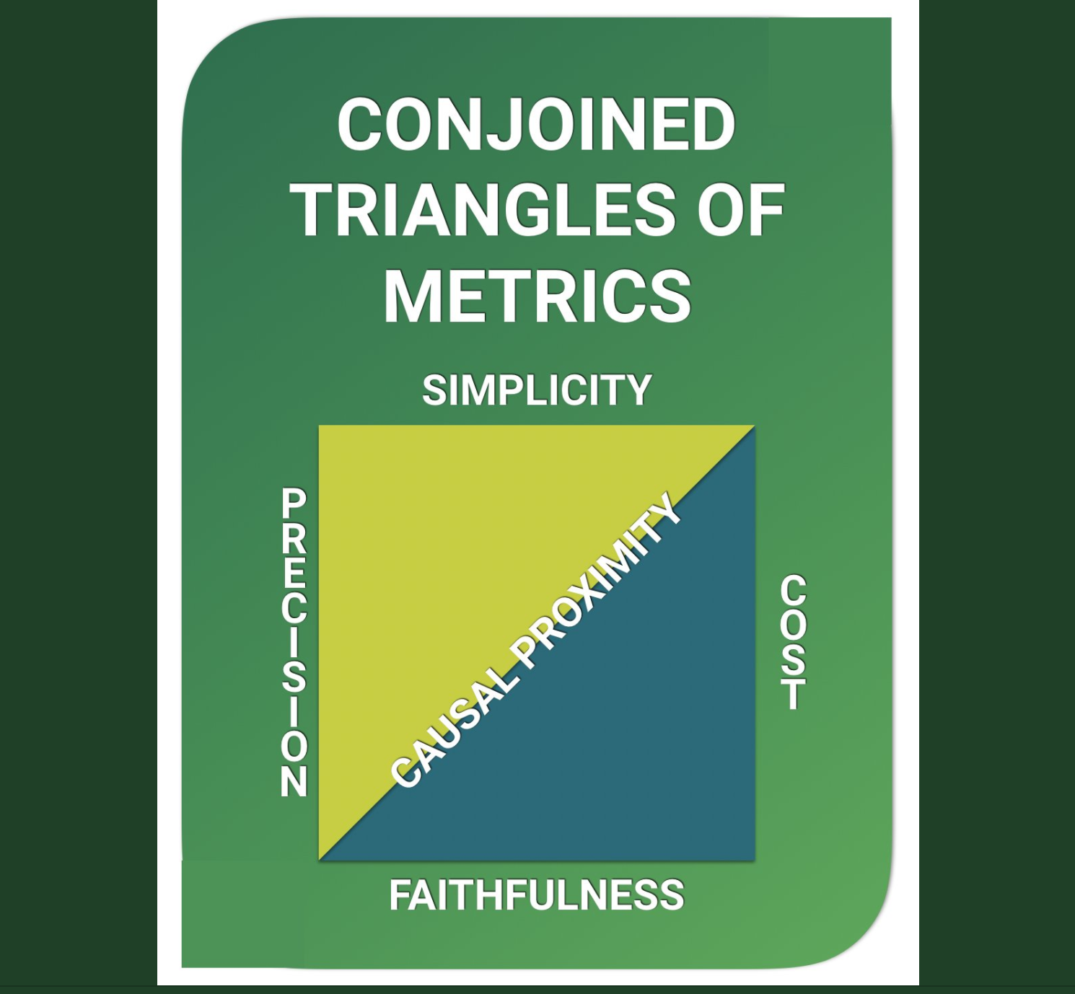
Measurement with Intention

Slide 15
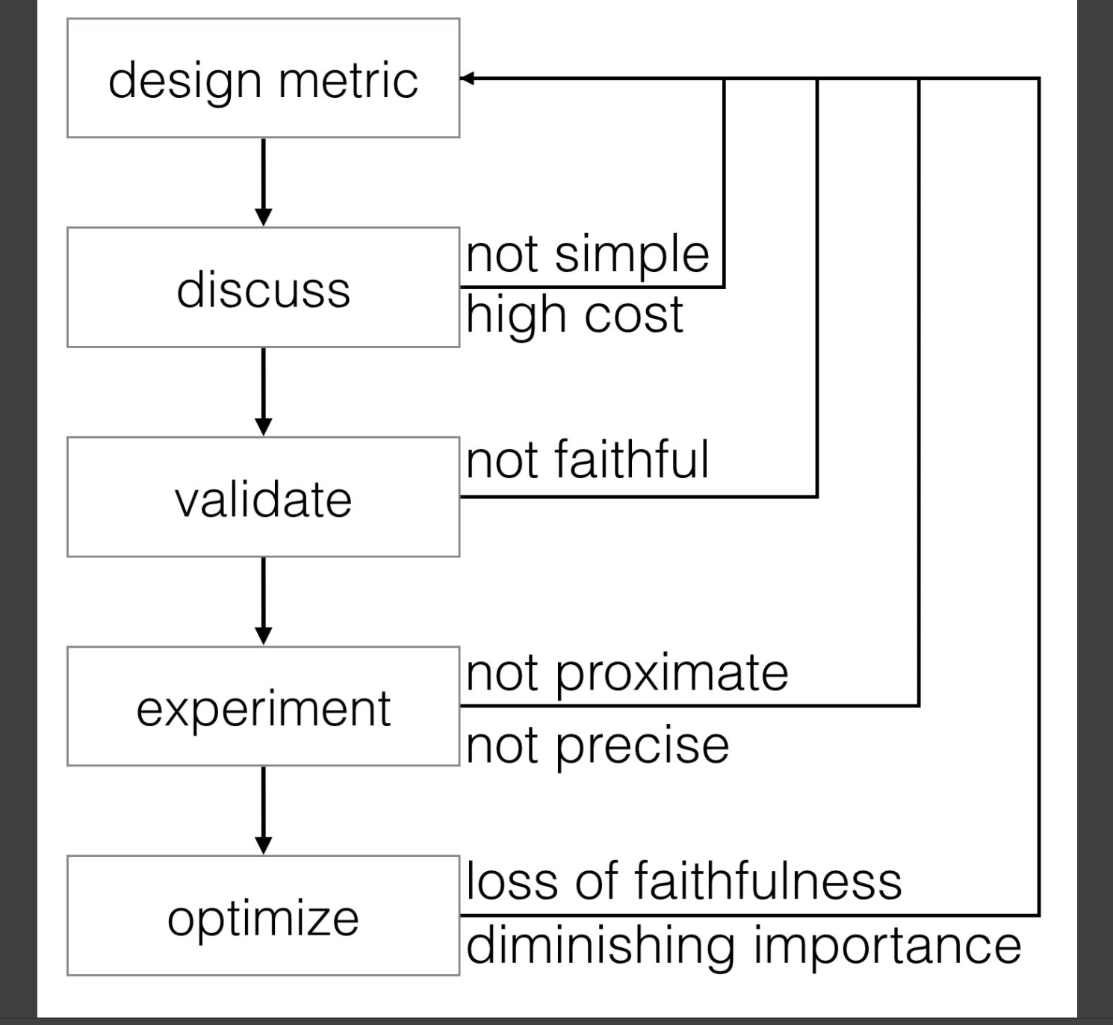
Measurement with Intention

Slide 16
Data Science in Industry
Measurement with Intention – Sean Taylor (Facebook)
“We never directly observe the processes we are trying to monitor”
What defines a good metric: Cost, Simplicity, Faithfulness, Precise and Casual Proximity
Unlocking the Power of Social Chatter;
Recent Endeavors @ Netflix - Sui Huang (Netflix)
Capitalizing and utilizing external data sources for model building.

Slide 17
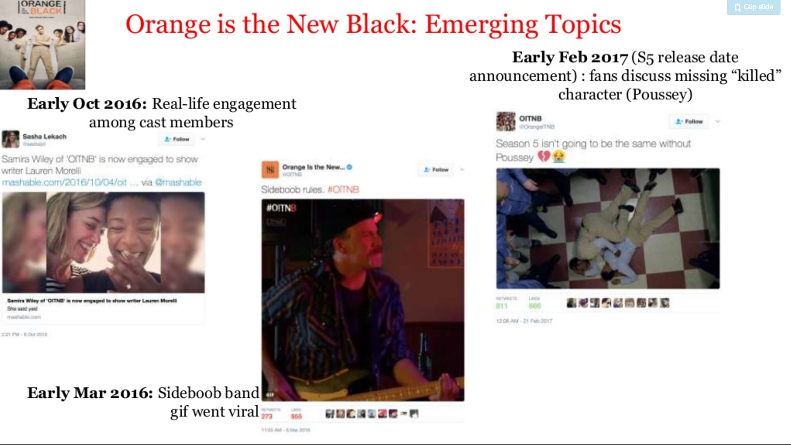
Unlocking the Power of Social Chatter

Slide 18
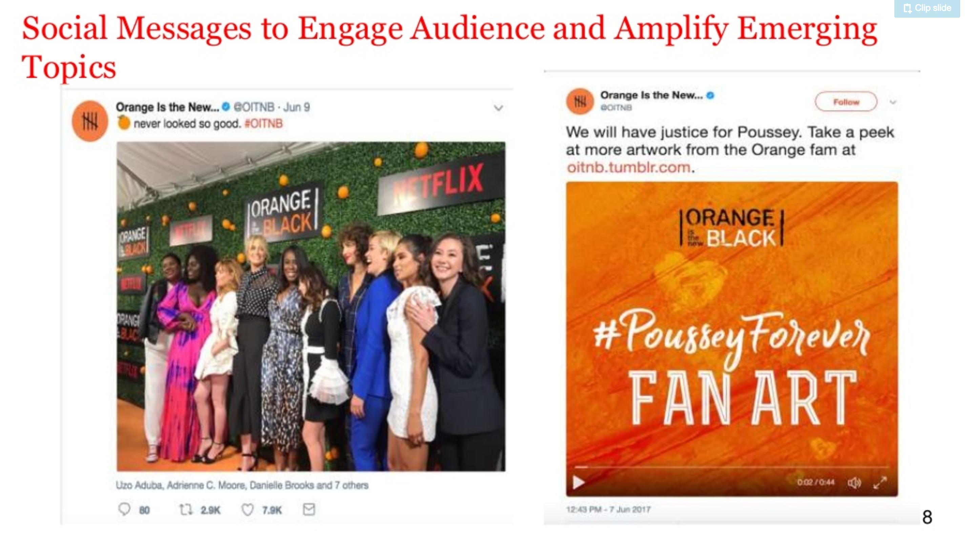
Unlocking the Power of Social Chatter

Slide 19
How to productionize data science models
Building Robust Pipelines with Airflow
– Erin Shellman (Zymergen)
Airflow as a solution for your Data Management Platform:
Scheduling
Monitoring
Reporting
2. Lessons From Integrating Machine Learning
Models into Data Products – Sharath Rao (Instacart)
Plan ahead to build product in synch with the constraint of the model.

Slide 20
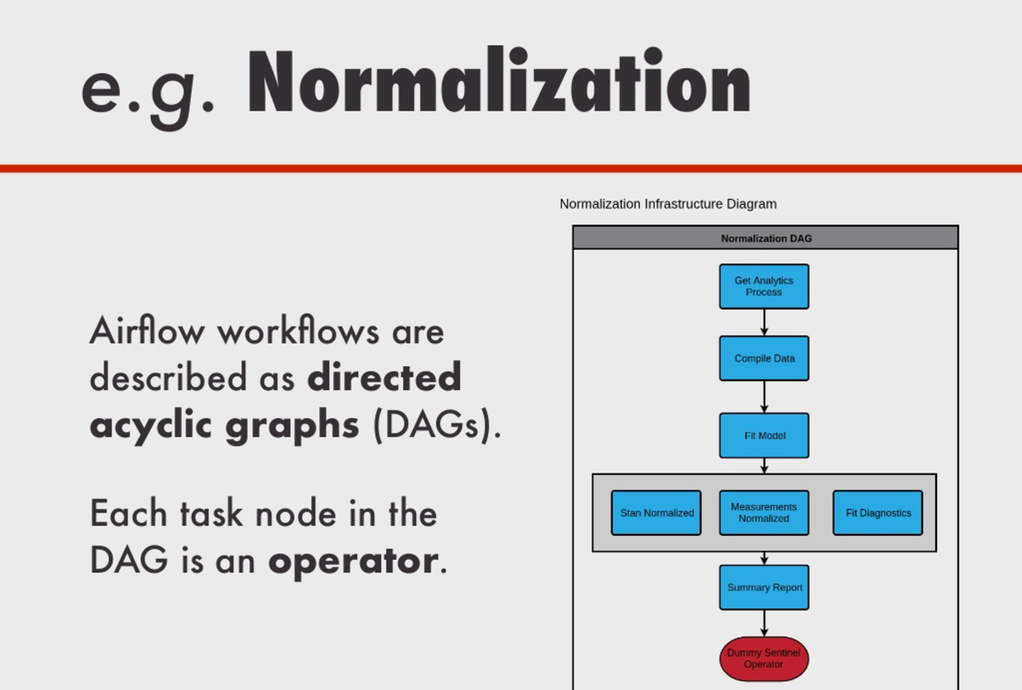
Building Robust Pipelines with Airflow

Slide 21
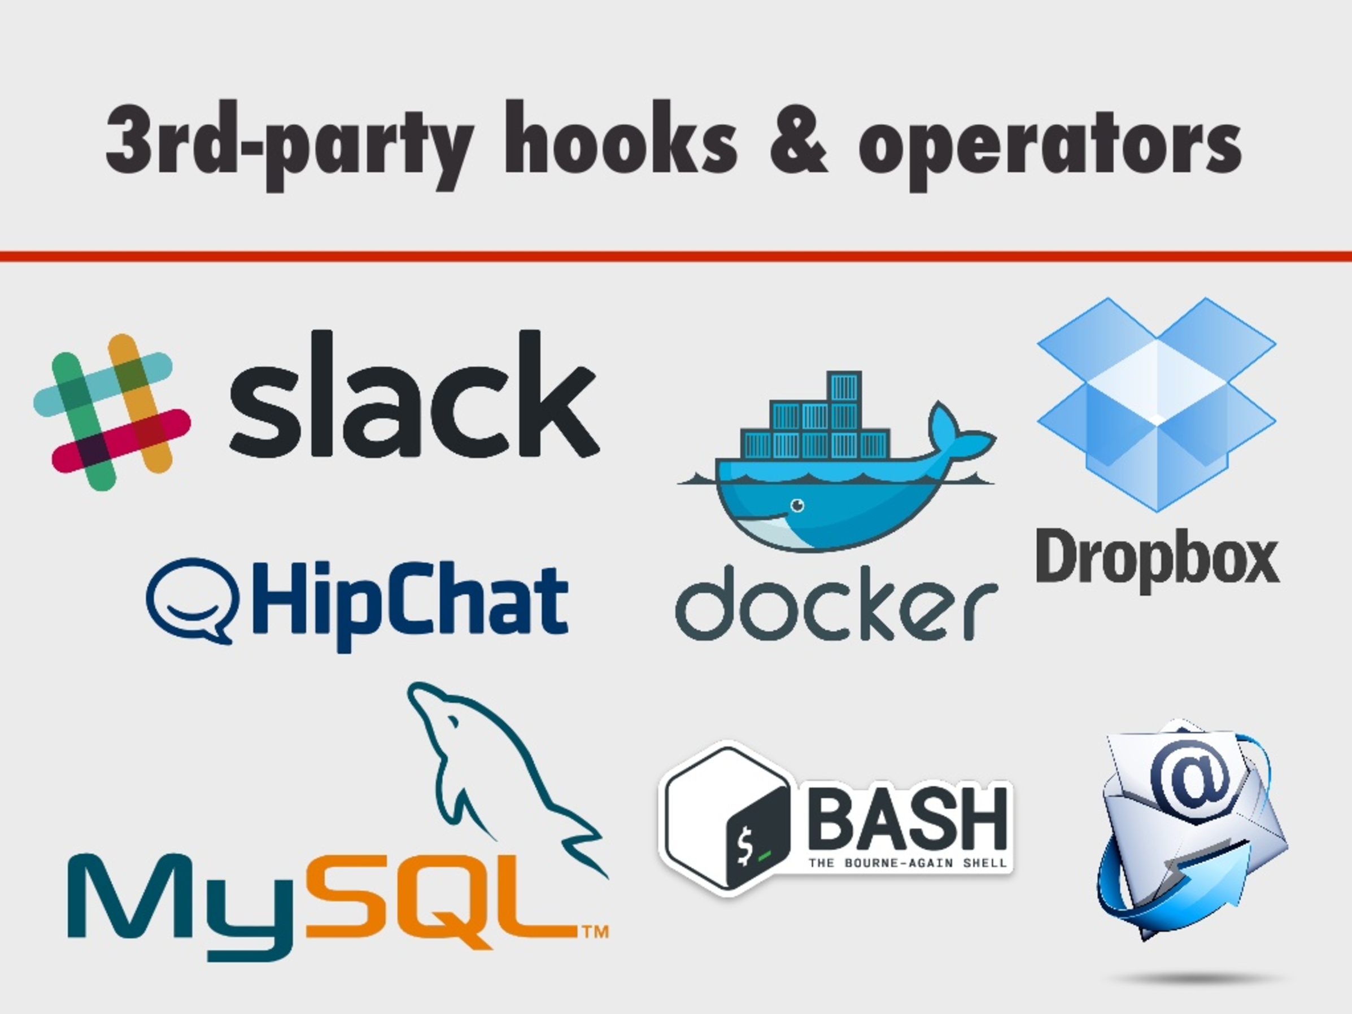
Building Robust Pipelines with Airflow

Slide 22
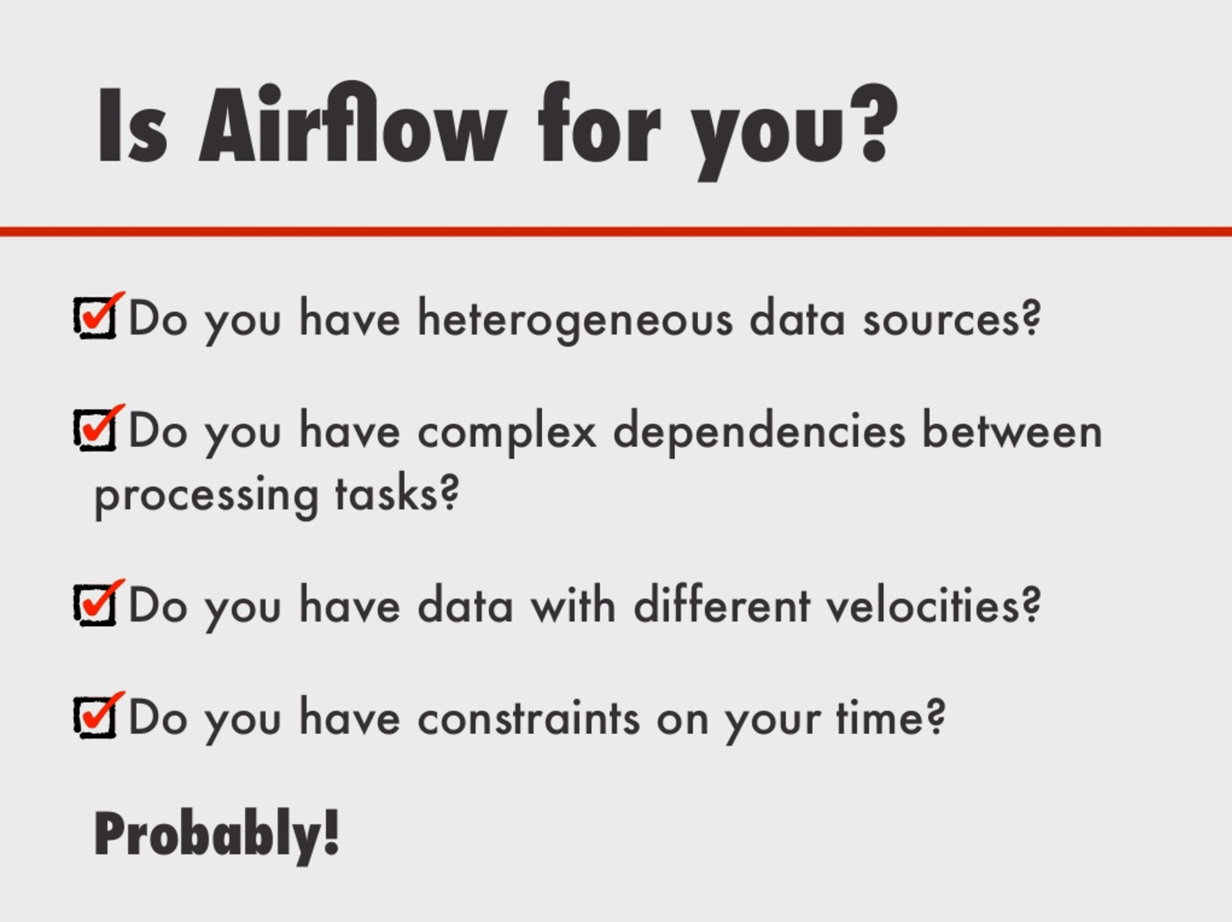
Building Robust Pipelines with Airflow

Slide 23
How to productionize data science models
Building Robust Pipelines with Airflow
– Erin Shellman (Zymergen)
Airflow as a solution for your Data Management Platform:
Scheduling
Monitoring
Reporting
2. Lessons From Integrating Machine Learning
Models into Data Products – Sharath Rao (Instacart)
Plan ahead to build product in synch with the constraint of the model.

Slide 24
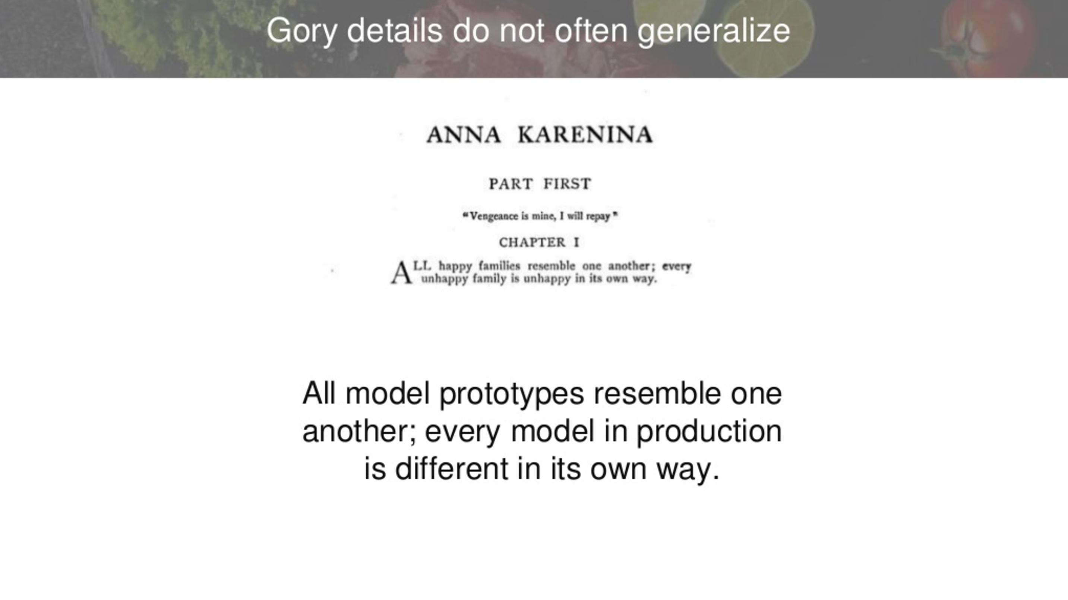
Integrating Machine Learning
Models into Data Products

Slide 25
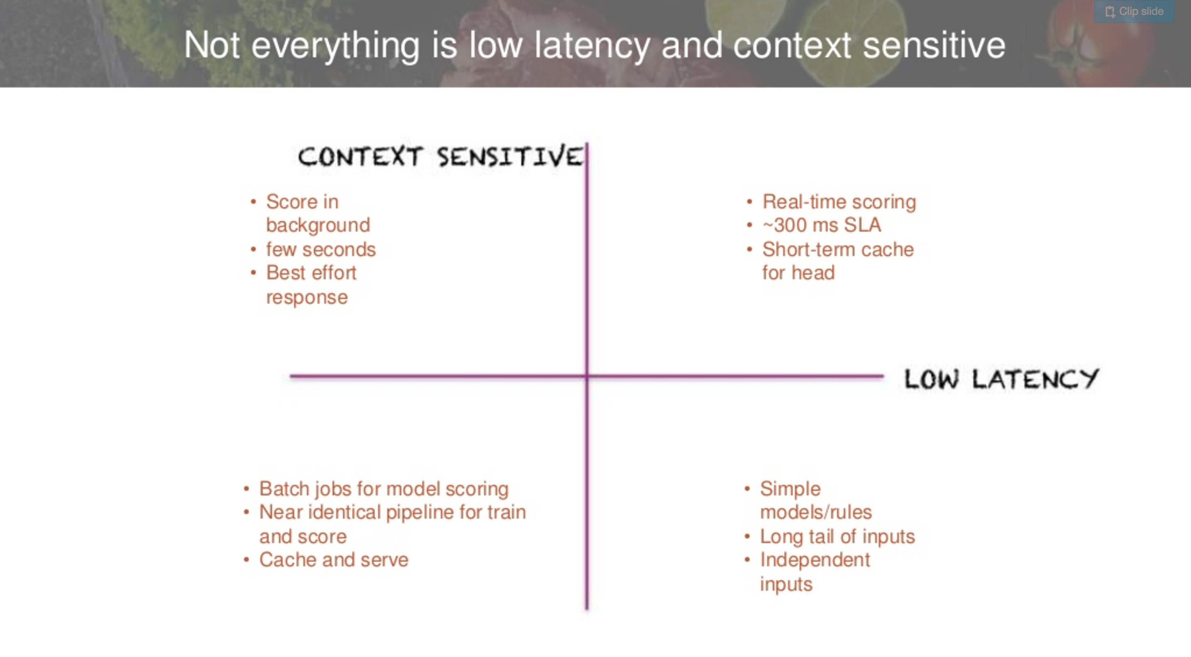
Integrating Machine Learning
Models into Data Products

Slide 26
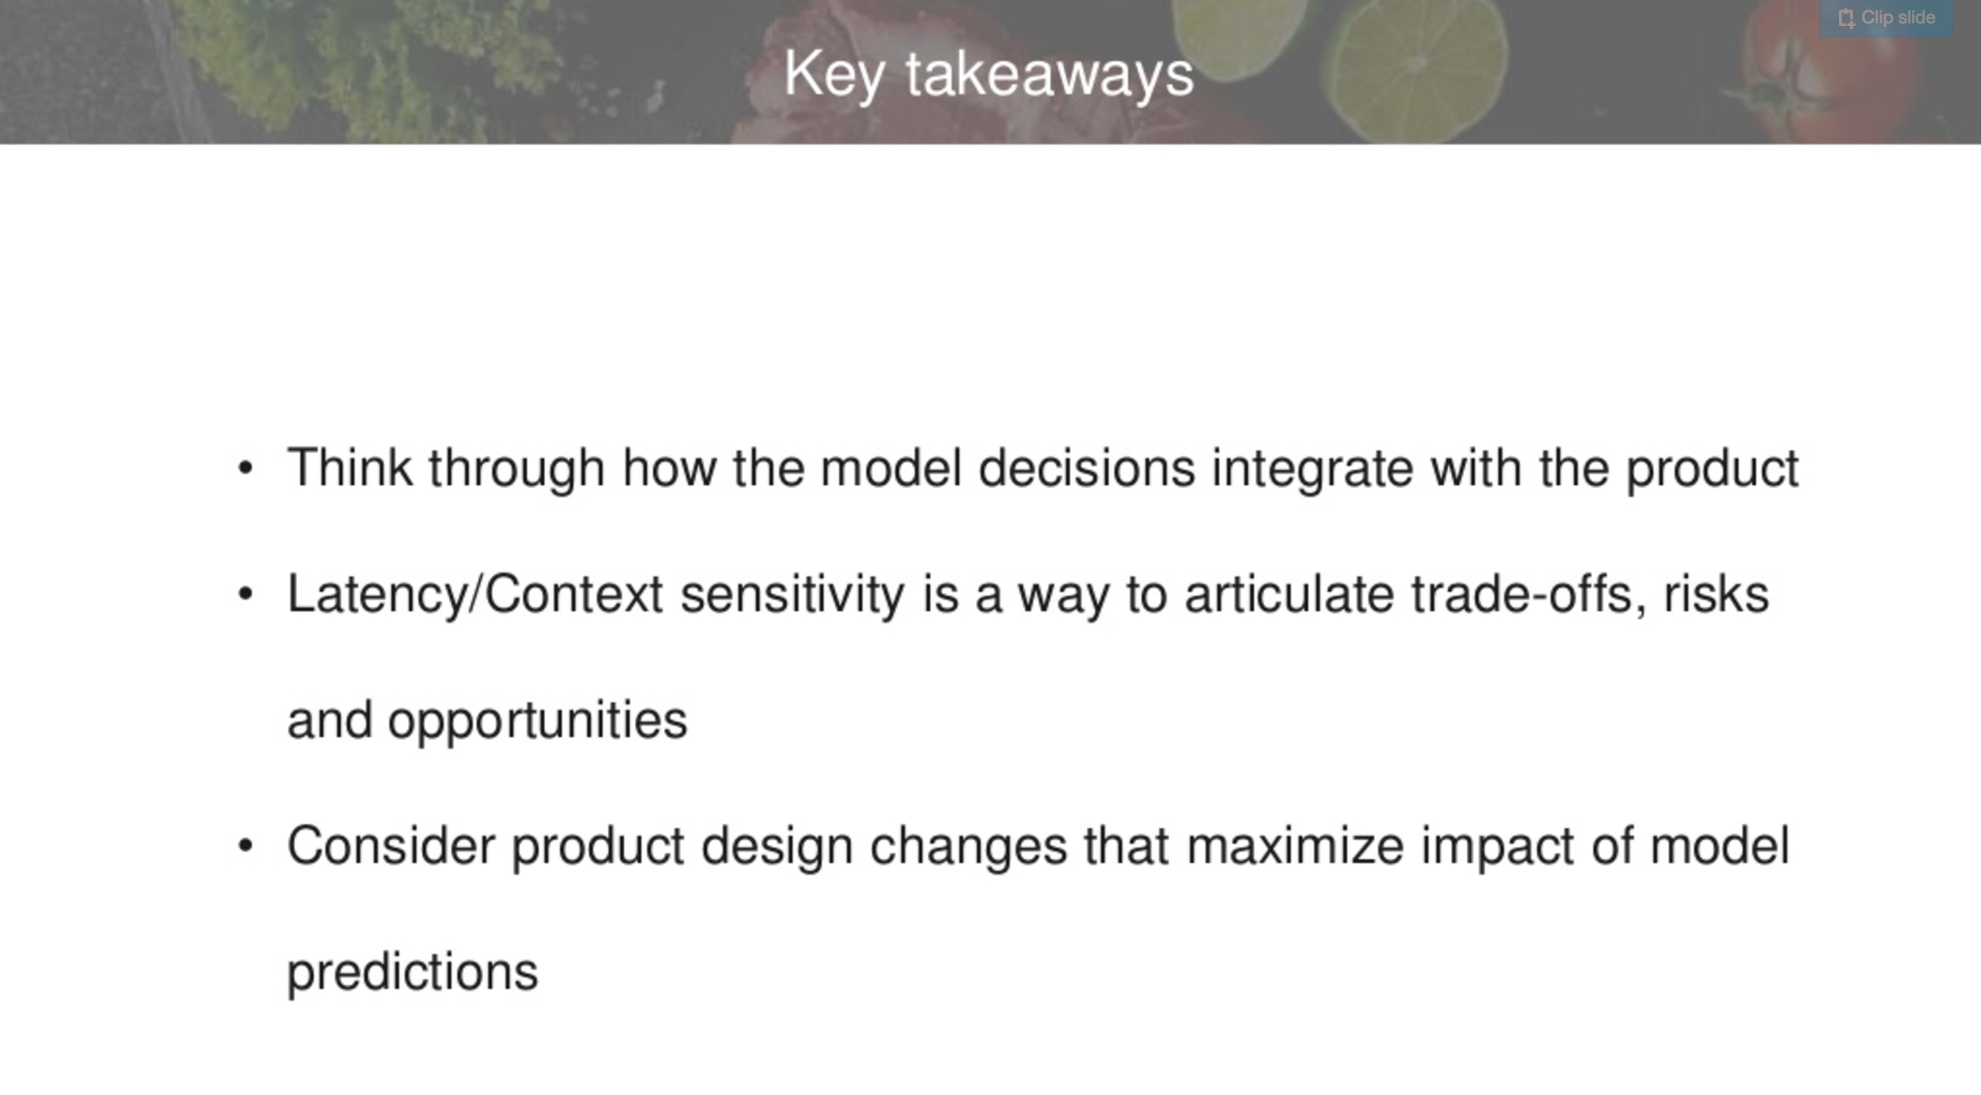
Integrating Machine Learning
Models into Data Products

Slide 27
References
https://www.slideshare.net/search/slideshow?searchfrom=header&q=wrangle+conference+2017&ud=any&ft=all&lang=**&sort=
http://wrangleconf.com/
https://twitter.com/hashtag/wrangleconf?f=tweets&vertical=default
http://martin.zinkevich.org/rules_of_ml/rules_of_ml.pdf

